Slide 1
CAR PRICE PREDICTION PROJECT
Submitted by
Khanin Deka

Slide 2
PROBLEM STATEMENT Build a machine learning model in order to predict the price of a pre-owned car.

Slide 3
The Dataset 1) The dataset contains 20911 rows and 10 columns. 2) Out of the 10columns, 7are of object data-type, 2 of float and 1 of int data-type. 3) There are some missing values in the Engine Capacity, Transmission and Fuel Type columns.

Slide 4
DATA PREPROCESSING
'Unnamed: 0' column is deleted.
1435 duplicate entries are found and removed.
All the values in the ‘Transmission’ column are mapped to 2 types: A for automatic and M for manual.
The entries in ‘Kms Driven’ column are in text format. They are converted to numeric type.
The ‘No. of Owners’ column contains 9 unique values in text format but they actually refer to 6 different types. The number of owners range from 0 to 5. 0 implies unregistered car and 5 implies 5 owners till now. All these 9 unique values are mapped to 6 values in integer format.
The minimum value in the ‘Engine Capacity’ column is 0 which is not possible for a working car. This entry is removed. The maximum value in ‘Kms Driven’ column is 74lakh. This is not a realistic number. All entries above 10lakh kms are removed. There were a total of 6 such entries.

Slide 5
The null values in the ‘Fuel Type’ and ‘Transmission’ columns are filled with mode of the respective column. The null values in ‘Engine Capacity’ column are filled using KNN (K-nearest neighbor) imputer with the no. of neighbors set to 5. The imputation of ‘Engine Capacity’ column is done after all the object data-type categorical columns are encoded.
'Brand', 'Model', 'Fuel Type', 'Transmission' and 'Location' columns are encoded using LabelEncoder of scikit-learn.
The skewness of ‘Engine Capacity’ and ‘Kms Driven’ column are found to be 1.9 and 4.1 respectively. The data in these columns are transformed using the PowerTransformer of scikit-learn. The ‘box-cox’ power transformation method was used and the skewness is brought down to acceptable level (-0.04 and 0.05 to be precise).
‘Brand’ and ‘Model’ columns are dropped as they have a very weak correlation with the target variable.
The features are scaled using StandardScaler of scikit-learn.

Slide 6
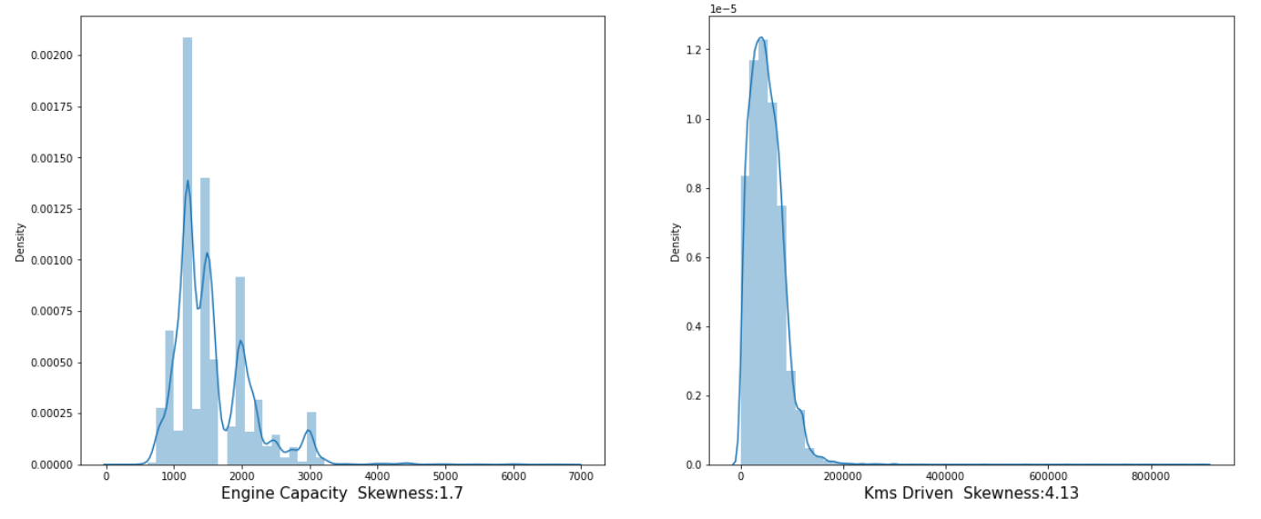
VISUALIZATION & OBSERVATIONS
Distribution plots of 'Engine Capacity’ and ‘Kms Driven’ column:
Observations:
1. The engine capacity of most of the cars range between 800 and 3500cc.
2. Most of the cars have not been driven beyond 2lakh kilometers.

Slide 7
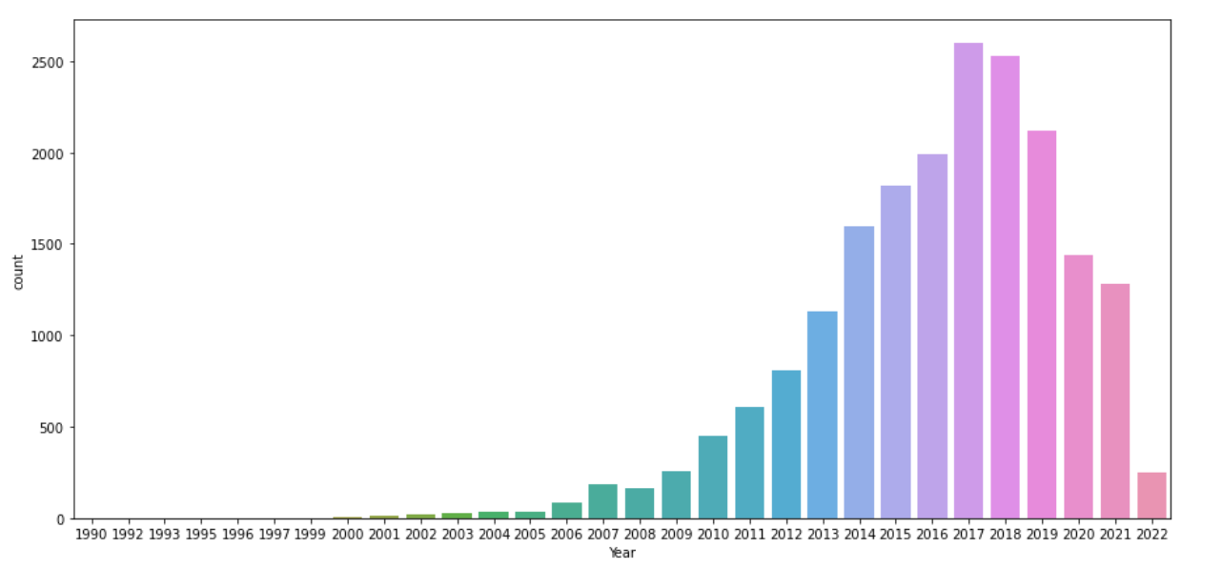
Count plot of ‘Year’ column: Observation: Majority of the cars are not older than 10 years since first brought.

Slide 8
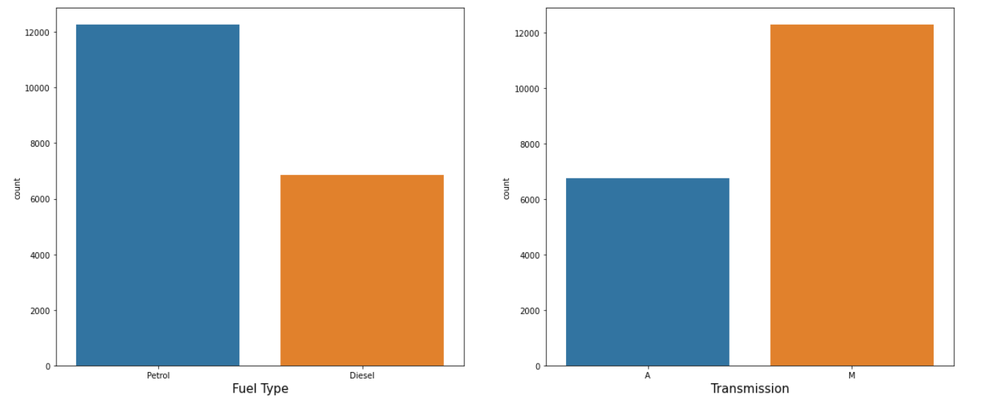
Count plots of ‘Fuel Type’ and ‘Transmission’ columns: Observations: 1. Majority of the cars in the dataset uses petrol as fuel. 2. Majority of the cars in the dataset have manual transmission.

Slide 9
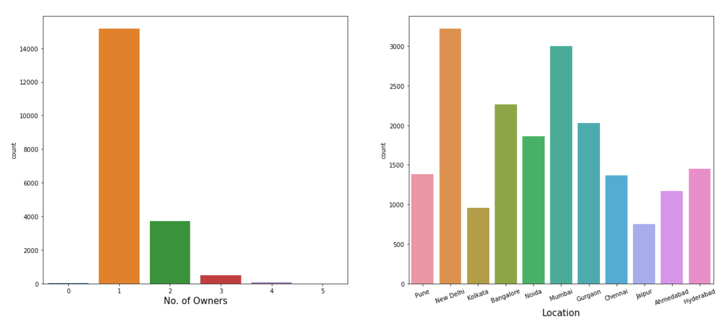
Count plots of ‘No. of Owners’ and ‘Location’ columns: Observations: 1. Majority of the pre-owned cars have 1 owner till now.

Slide 10
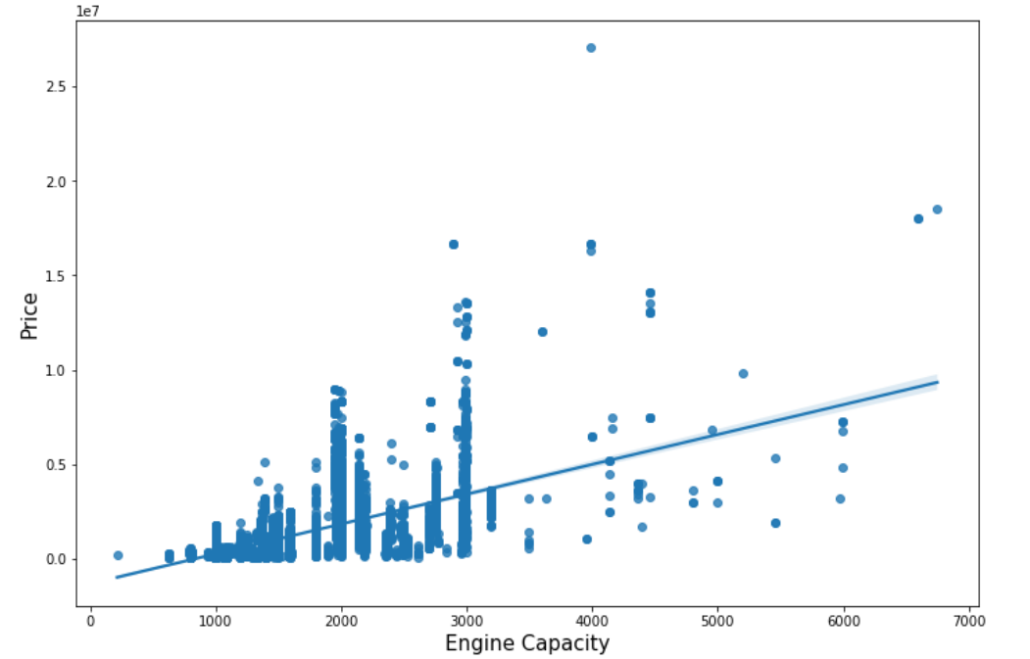
Regression plot of ‘Engine Capacity’ vs ‘Price’: Observation: A positive linear relation can be seen.

Slide 11
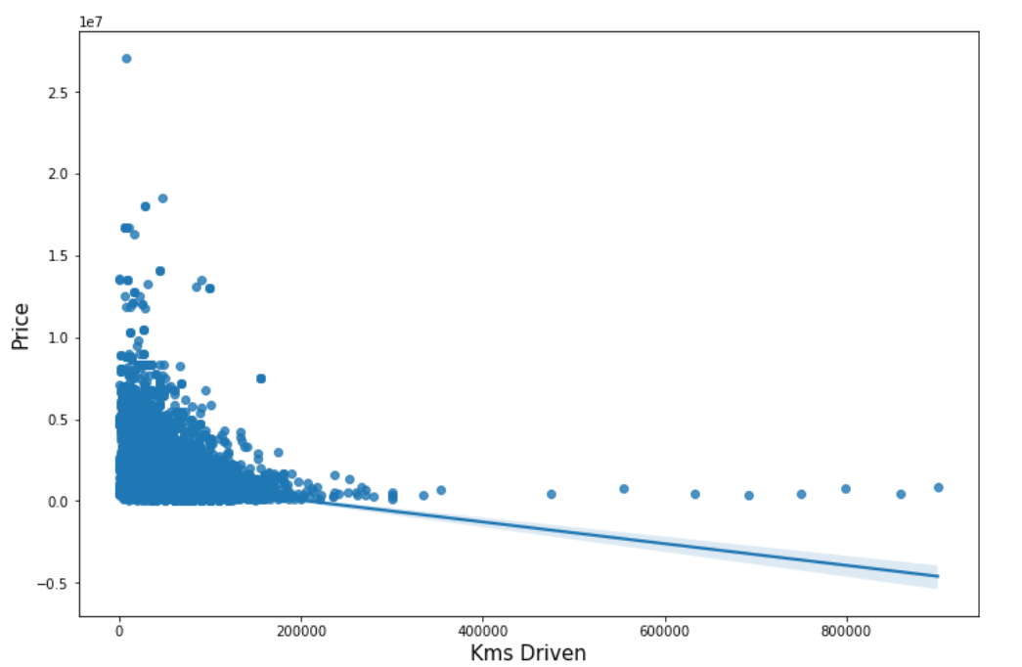
Regression plot of ‘Kms Driven’ vs ‘Price’: Observation: A negative linear relation can be seen. Cars which have travelled higher distance have lower price in general.

Slide 12
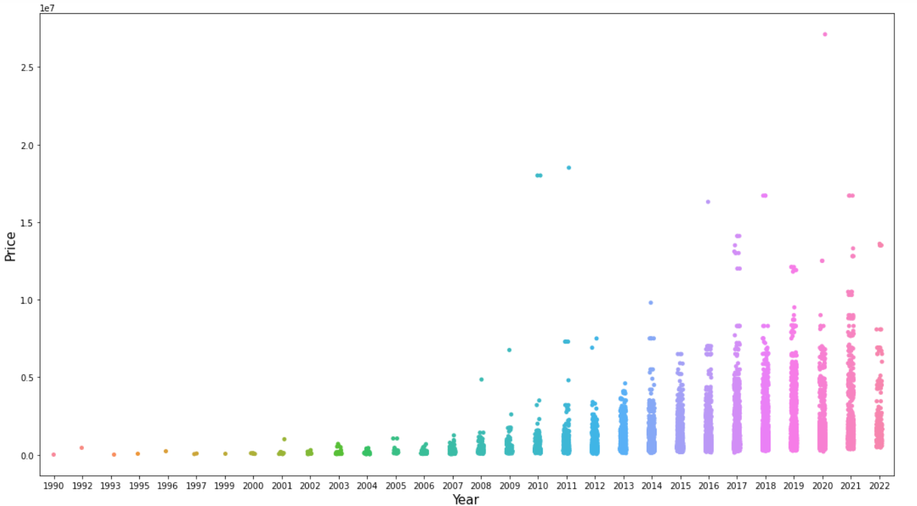
Strip plot of ‘Year’ vs ‘Price’: Observation: Older cars have lower value.

Slide 13
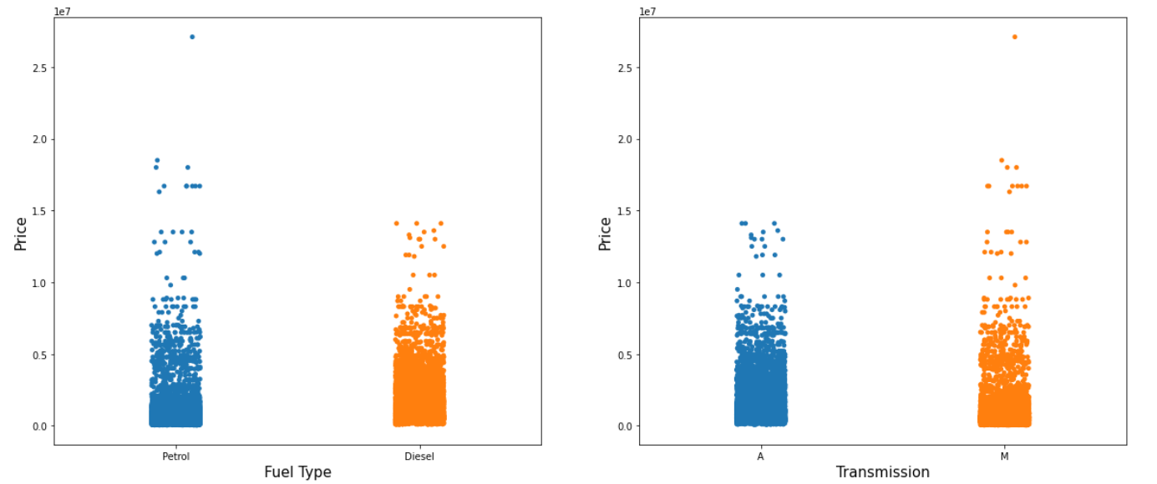
Strip plots of ‘Fuel Type’ and ‘Transmission’ vs ‘Price’:

Slide 14
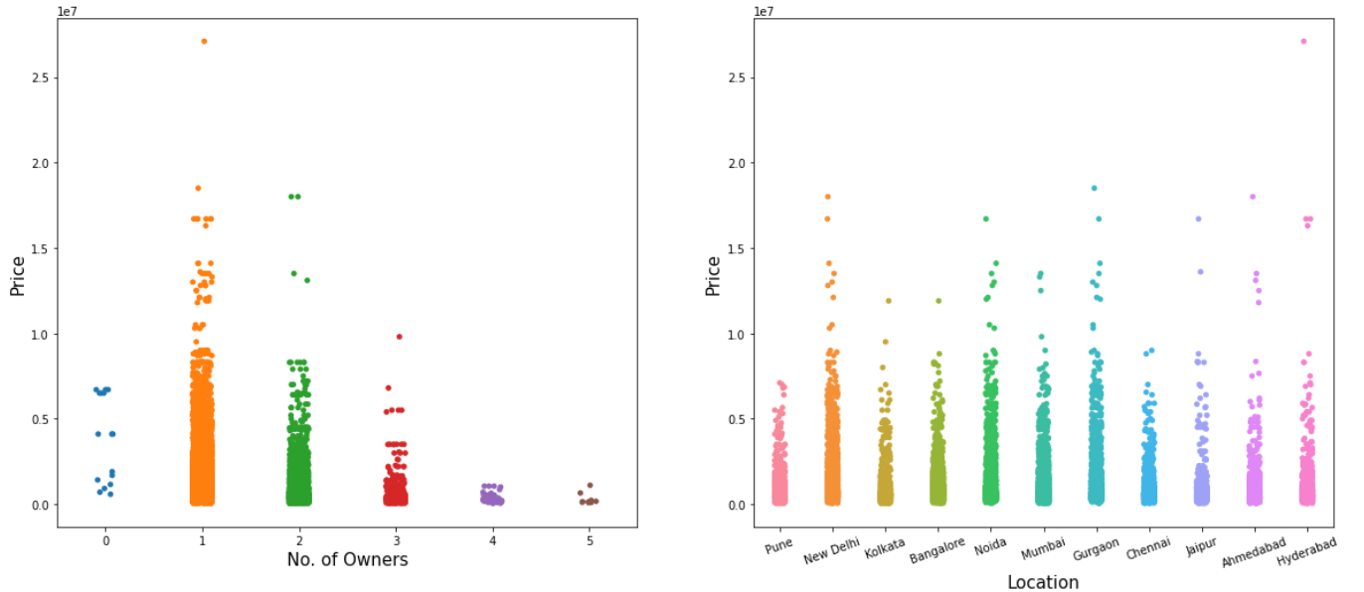
Strip plots of ‘No. of Owners’ and ‘Location’ vs ‘Price’: Observation: As the number of owners of the car increase the price gets reduced.

Slide 15
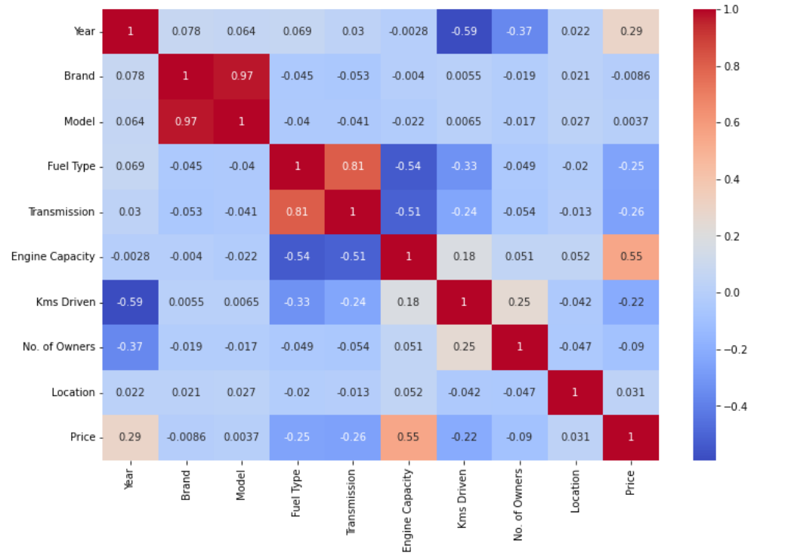
Correlation Heatmap: Observations: 1. ‘Engine Capacity’ has the strongest correlation with price of the vehicle. 2. The ‘Brand’ and ‘Model’ seems to have a very weak relation with price. 3. ‘Brand’ and ‘Model’ have a multicollinearity issue.

Slide 16
Performance Evaluation
We will use the coefficient of determination (R²) to evaluate the models’ performance. The R² score for a model is a useful statistic in regression analysis, as it often describes how ‘good’ that model is at making predictions.
The performance is evaluated for five different algorithms. They are: a) Linear Regression
b) AdaBoost Regression
c) Random Forests Regression
d) XGBoost Regression
e) KNN Regression.
First the scores are observed for 5 different train-test splits and then the score is cross-validated for each of the models.

Slide 17
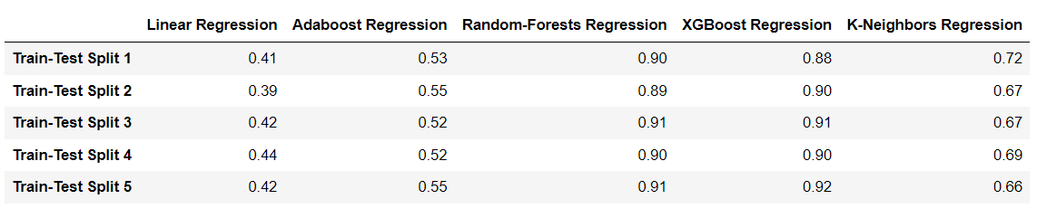
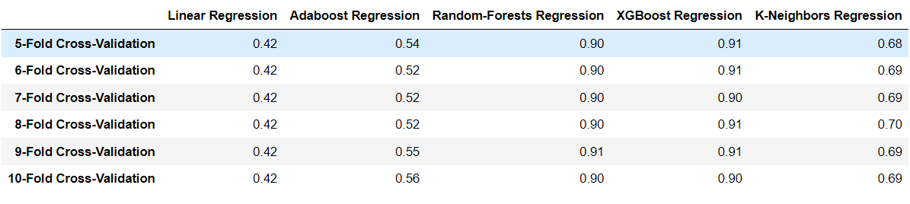
Let’s see the R² scores of the 5 different algorithms on 5 different train-test splits: Let’s see the cross-validation results: From the above results it can be seen that Random-Forests and XGBoost is giving the best results. Let’s try to tune their hyperparameters.

Slide 18
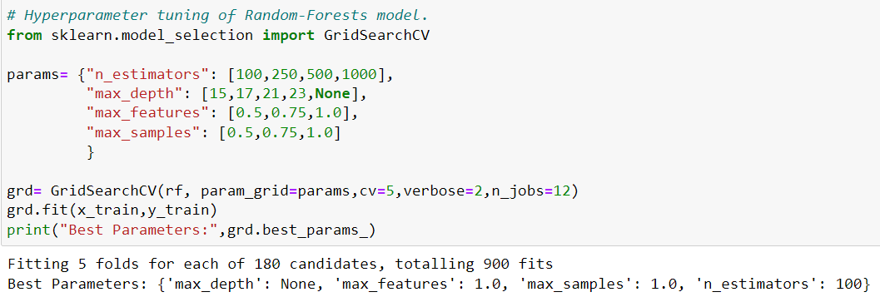
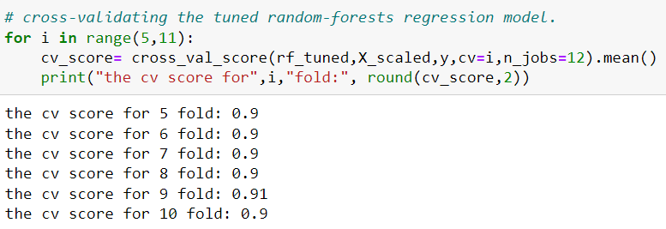
Hyper-parameter tuning of Random-Forests Model: Cross validation results of the tuned model:

Slide 19
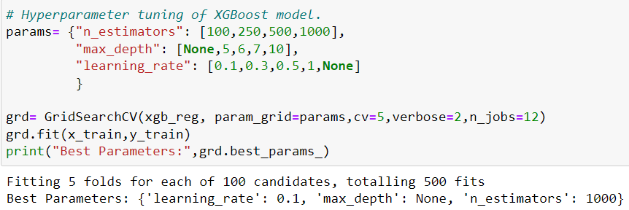
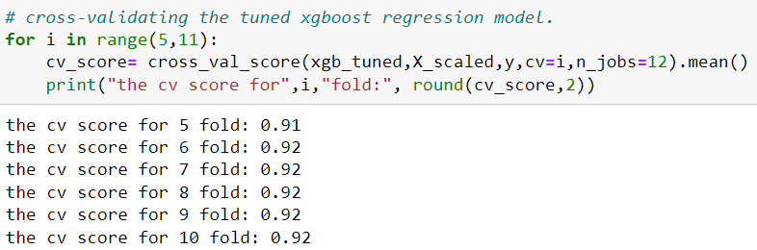
Hyper-parameter tuning of XGBoost Model: Cross validation results of the tuned model: We can see that the XGBoost model is giving slightly better results in cross-validation as compared to the Random-Forests model.

Slide 20
CONCLUSION Key Findings: 1. The list of features affecting the price most, in descending order are: a) Engine capacity b) Year when the car was first purchased c) Transmission type d) Fuel type e) Distance travelled by the car till now. f) Number of owners till now. 2. XGBoost Regression Algorithm is giving the best results for prediction of price. Limitations of this work: 1. The hyper-parameters of our final model can be further tuned. 2. In data collection phase we collected data of 9 features and the price. Some more feature data can also be collected. For example, whether the car has been in any accident, seating capacity, etc. 2. In this project we worked on only 5 algorithms. There are numerous other regression algorithms with which we can try to make a better model.

